Slide 1

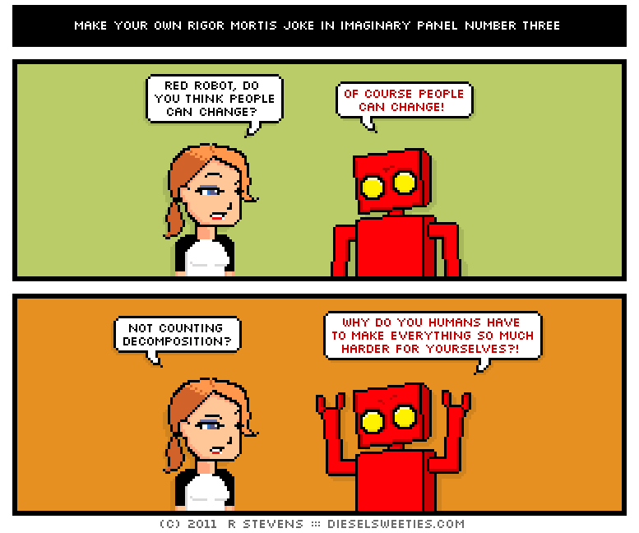
Lecture 3
CS 3810
LECTURE 2
How to attack a problem
Reference Types

Slide 2
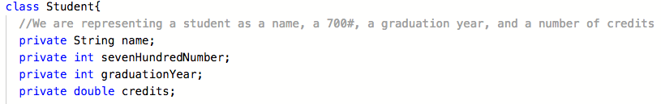
LAST TIME WE REVIEWED CLASSES
we made a student class
Abstraction: We chose to represent a student as 4 pieces of data.
These were our private variables
Private means they can not be accessed directly from outside the Class code

Slide 3
QUESTION HOW DO WE INITIALIZE A STUDENT?
Private means they can not be accessed directly from outside the Class code
How do we initialize all these private variables from inside student from outside the class?
name=??
sevenHundredNumber= ??
graduationYear=??
credits=??
The object ashTrash has 4 private variables inside

Slide 4
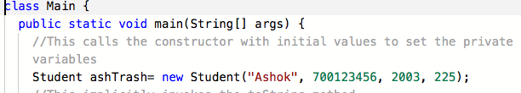
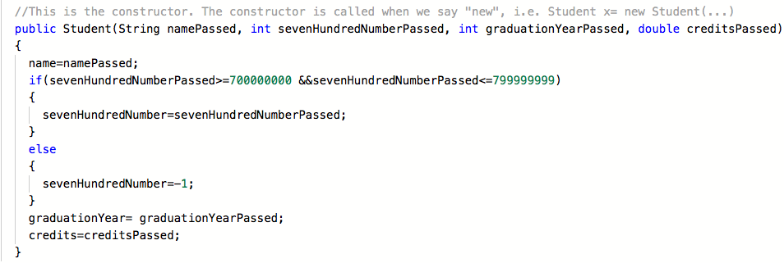
ANSWER: BY CREATING A PUBLIC CONSTRUCTOR THAT INITIALIZES ALL THE PRIVATE VARIABLES

Slide 5
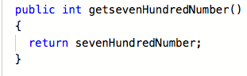
QUESTION HOW DO WE GET THE PRIVATE VARIABLE VALUES?
CREATE A PUBLIC GETTER METHOD
It returns the a value of the private variable
Typically we make one of these for each private variable

Slide 6
HOW TO ATTACK A HOMEWORK (OR ANY CODING PROBLEM)
Divide and conquer— split problem up into little pieces, implement those pieces
Implement it Piece by Piece
Test each piece out and make sure it works before going to the next piece
  We write test code in the CLIENT, i.e. main.java
How do we do this?
Simple!
identifying the smallest amount of code you need to test if something works
Implement those things
Write test code in main
Go back Step 1 and implement the next thing! Repeat until finished!
The advantage of this is that
1)You are confident that previous step works before going to the next step
2) You know exactly what piece of code does not work
3) Debugging becomes much easier
DO NOT IMPLEMENT EVERYTHING AT ONCE!

Slide 7
TASK: Let’s say we identify our task of write the Constructor
We know that the Constructor initializes private variables
TPS
1): What Methods in the Class do we have to write to accomplish the code development and testing of this task
2) What code in the Client do we have to write to accomplish the testing of this task?
www.questionpress.com/ashok
Note to self— answers on next hidden slide

Slide 8
TPS1 ANSW) CONSTRUCTOR, GETTERS IN THE CLASS
TPS 2 ANSW) CODE THAT CREATES THE OBJECT AND PRINTS OUT THE VARIABLES USING THE GETTERS IN THE CLIENT
Next Task: we write the toString method and test that
At this point we would identify the next task…Maybe writing the Setters for one of the private variables. Then test that. Then write another setter, then test that. etc. keep in mind what invalid values are when writing the setters and test setting the private variables to these values
Then we might write any other function that is left and test.
This is how the successful students in the class will attack a problem from here on out!

Slide 9
LAST TIME WE STARTED TO MAKE OUR OWN OBJECT TYPE
WE ENDED WITH OVERLOADING TOSTRING AND EQUALS

Slide 10
MECHANICS OF OVERRIDING TOSTRING

Slide 11
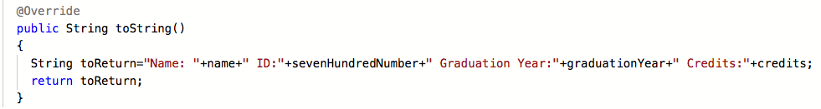
OVERRIDING TOSTRING
click here for code
Concept: Classes and Java Review
Purpose: How Classes work in Java
Lecture 1
What happens when we try to print out an object of a class without a toString? Java will print out something called an object hash code— it looks something like this: 6969504
Each object in a program has a unique hash code
If we try to print out ashTrash and get some weird string of numbers that would be no good!
To avoid this we must Override the toString method. We will talk about overriding in a few slides
Student.java
The toString method allows us, the class designers, to determine what the String representation for our object should look like. toString returns a String representation of our object

Slide 12
OVERRIDE REFERS TO THE FACT THAT EVERY CLASS INHERITS FROM THE “GLOBAL BASE CLASS” OBJECT IN JAVA
Lecture 1
Concept: Classes and Java Review
Purpose: How Classes work in Java
“EVERY CLASS IS AN OBJECT”
Object defines its own toString Method, so if you write a class without a toString method, it’ll use Object’s toString method (which just prints out a random number called the object hashcode).
More on this in the next lecture

Slide 13
OVERRIDING TOSTRING
click here for codhttps://suny-ow-edu.zoom.us/rec/share/FUQbqqmVY2DVolYO4dQ5hjhj0xfuc4VIWpxlpIZqlHuACMdgTpnwv8dp7g-o7J7h.x2GtqDny2UzkSALm
e
Concept: Classes and Java Review
Purpose: How Classes work in Java
Lecture 1
toString can be invoked explicitly
String ashStringRep= ashTrash.toString();
But Typically it’s invoked Implicitly whenever you need a String representation of our object (i.e. like in System.out.println)
invokes toString
and will evaluate to whatever String is returned
Student.java

Slide 14
MECHANICS OF OVERRIDING EQUALS

Slide 15
OVERRIDE REFERS TO THE FACT THAT EVERY CLASS INHERITS FROM THE “GLOBAL BASE CLASS” OBJECT IN JAVA
Lecture 1
Concept: Classes and Java Review
Purpose: How Classes work in Java
“EVERY CLASS IS AN OBJECT”
Object defines its own toString Method, so if you write a class without a toString method, it’ll use Object’s toString method (which just prints out a random number called the object hashcode).

Slide 16
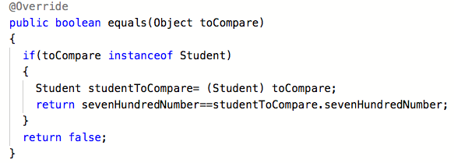
THE OTHER THING WE HAVE TO OVERRIDE IN OUR CLASS (FROM OBJECT) IS CALLED EQUALS
Lecture 1
Concept: Classes and Java Review
Purpose: How Classes work in Java
What does it mean if we have Student A and Student B— what does it mean for these to be equal?
A.equals(B) will only be true if they are the same object in memory— THIS IS INCORRECT because if Student A and Student B could have the same, for example student ID number, and in that case maybe we want to declare them the same student
to Compare two objects of our class we must override equals
to Override a method we must match the function prototype exactly, Object’s equals takes in an Object as a parameter, thus we must match this in our class.
Note equals returns a boolean

Slide 17
WE ALWAYS DO THE FOLLOWING WHEN WE OVERRIDE EQUALS
Check whether the OBJECT type parameter passed in is actually the same type as our CLASS
Cast the parameter to our class
Check if some subsection of private variables of both objects equal each other
Return true or false
this is convention for any override but not required
should actually use the getters (i.e. getsevenHundredNumber), bad programming practice
but still works because objects of the same class can directly access each others private variables

Slide 18
2 QUESTIONS:
1)WHY DO CLASSES NEED TOSTRING AND EQUALS?
2) AND WHY ARE THEY OVERRIDED?
These are deep questions, and to begin this discussion we have to talk about
Question 1 We’ll answer today and involves reference or object types and
Question 2 we’ll answer later and involves inheritance

Slide 19
Lecture 3
Concept: Primitive and Reference Types
Purpose: How Types work in Java

Slide 20
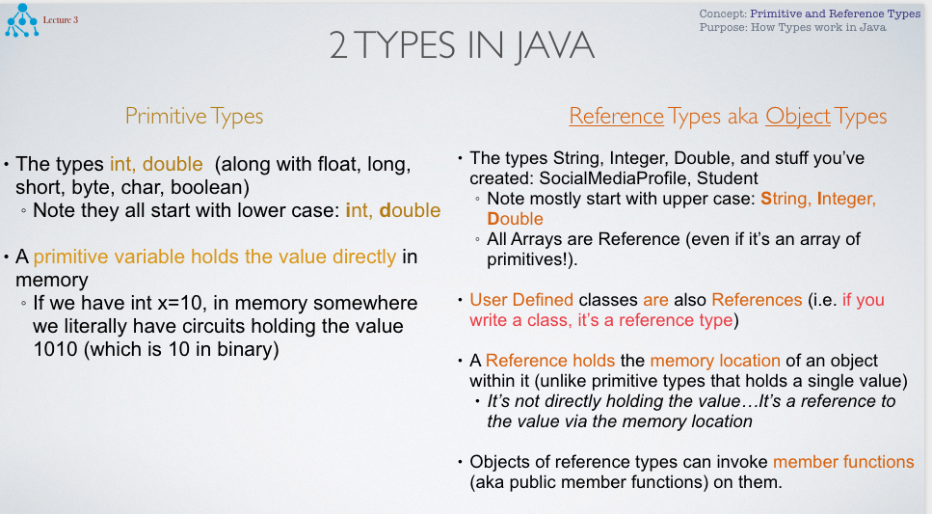

Slide 21
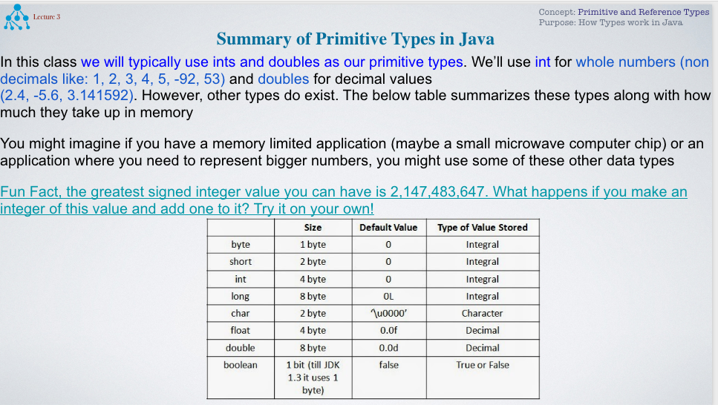

Slide 22
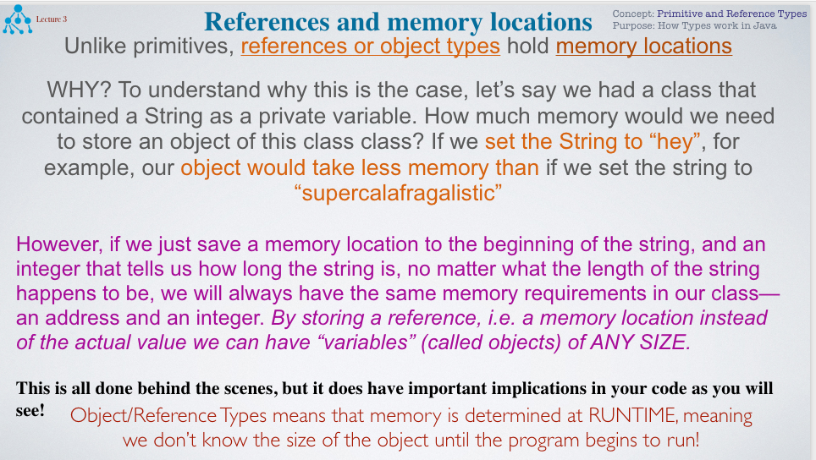

Slide 23
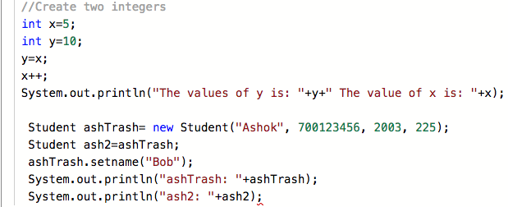
WHAT DOES THIS MEAN?
Lecture 3
Concept: Primitive and Reference Types
Purpose: How Types work in Java
TPS: Discuss with your neighbor what will happen in the following code
what will Y’s value be by code’s end? What will ash2’s value be by code’s end?
AFTER you submit, run the code here!
https://repl.it/@ashokbasawapatna/Object-Types-Vs-Primitives

Slide 24
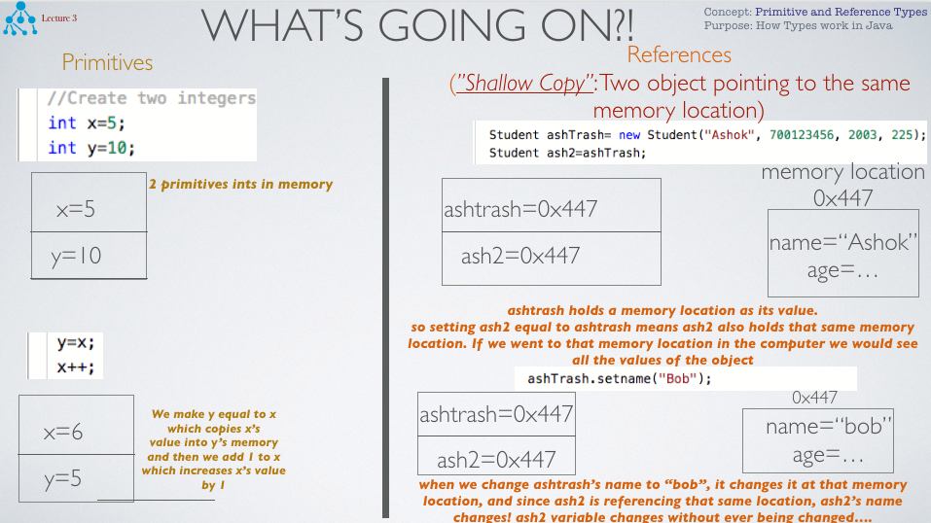

Slide 25
SO HOW DO WE COPY OBJECTS IN JAVA SUCH THAT EACH OBJECT HAS IT’S OWN COPY IN MEMORY?
“DEEP COPY”: TWO OBJECTS WITH THE SAME VALUES BUT EACH HAS THEIR OWN MEMORY LOCATION
Basically how do we get the following with reference types?
memory location
0x447
name=“Ashok”
age=…
ashtrash=0x447
ash2=0x992
memory location
0x992
name=“Ashok”
age=…
Note each variable, ashtrash and ash2, references (or ”points to”) different memory locations

Slide 26
QUESTION 1: HOW DO THESE REFERENCE OR OBJECT TYPES GET THEIR OWN MEMORY LOCATIONS?
The new keyword
saying new invokes the constructor
Notice we used the new keyword with ashtrash object, giving it a memory location
However, for ash2 object, we set equal to ashTrash, ash2 never invoked the new keyword and thus never got its own memory location!

Slide 27
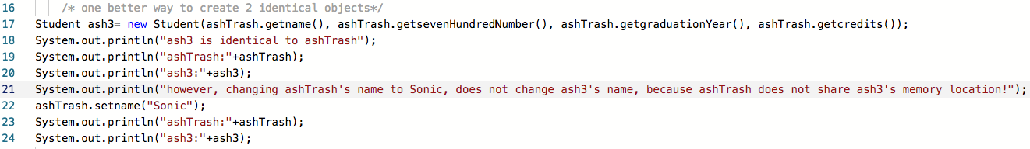
HOW DO YOU DEEP COPY OBJECTS IN JAVA?
So instead of this
  We Could pass the values from the object we want to copy into the constructor
  This will work in this case! we’ll learn a better way later (clone)
  Note that if the parameters were object/reference types, we may have to DEEP copy them within the body of the constructor (sometimes we don’t need a deep copy of these, more on this later)
  (String in this case acts like a primitive type, don’t worry about this right now)
click here for code

Slide 28
SOMETIMES WE WANT A DEEP COPY
SOMETIMES WE WANT A SHALLOW COPY
We will see situations this semester when we will have shallow copies and deep copies
DEEP COPY
two objects pointing to different memory locations but with same values..
SHALLOW COPY
two objects pointing to same memory location
memory location
0x447
memory location
0x447
ashtrash=0x447
name=“Ashok”
age=…
name=“Ashok”
age=…
ashtrash=0x447
ash2=0x447
ash2=0x992
Shallow copy: If we want a change in the object to yield a change in all the references
memory location
0x992
name=“Ashok”
age=…
Deep Copy: If we want a change in the object to not yield a change in all the references

Slide 29
WHY DO WE NEED A TOSTRING
In primitives, the string representation is obvious— i.e. if int x=4;
Our string representation of this will be “4”
toString allows us to convert our reference type to a string—
We get to pick the format and the variables we print out to the console
For Student we picked a string representation that printed out all the
Private variables, but we could have just as easily just printed out the name and ID number,
or the name and graduation year etc.
https://repl.it/@ashokbasawapatna/StudentClassExample

Slide 30
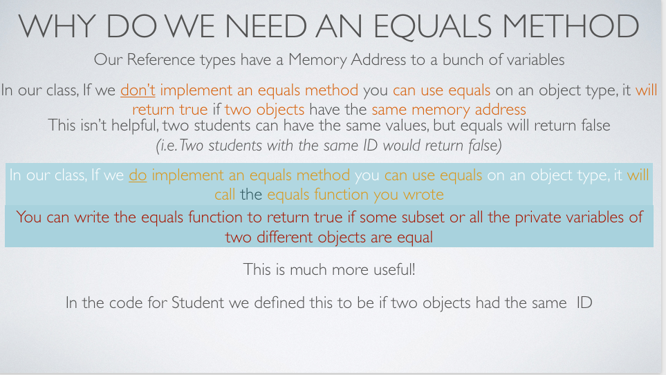

Slide 31

REFERENCE WRAP UP: NULL REFERENCE
TPS: Try the following Code and Describe What Happens
Comment out the code a the bottom here:
https://repl.it/@ashokbasawapatna/Object-Types-Vs-Primitives
Can you run it? What happens when you hoover your mouse over ash5?
If we don’t want our reference to point to anything, we point it null
when a reference is created and is not pointed to something, it points to null
More on this next lecture

Slide 32
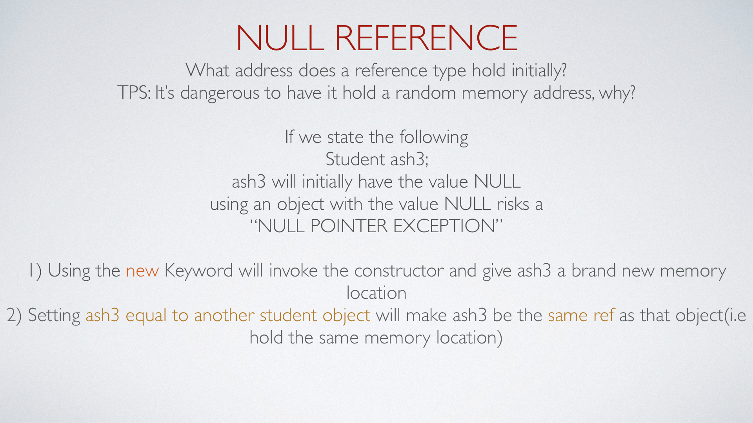

Slide 33
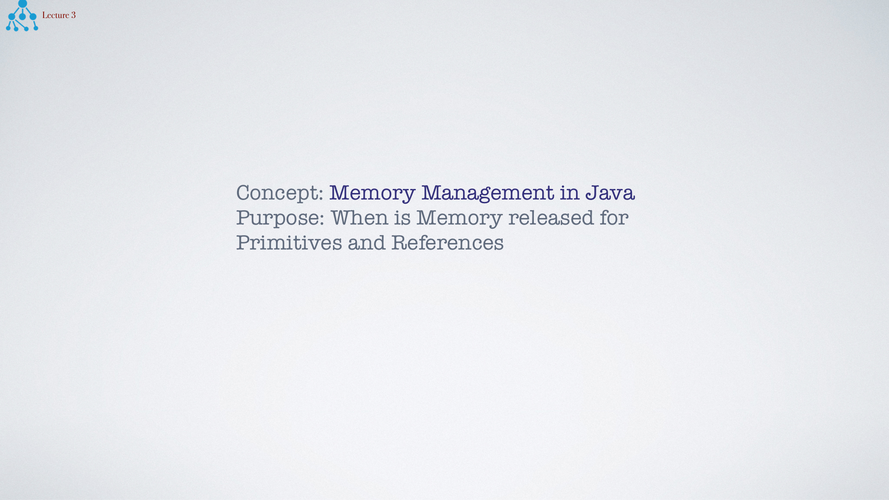

Slide 34
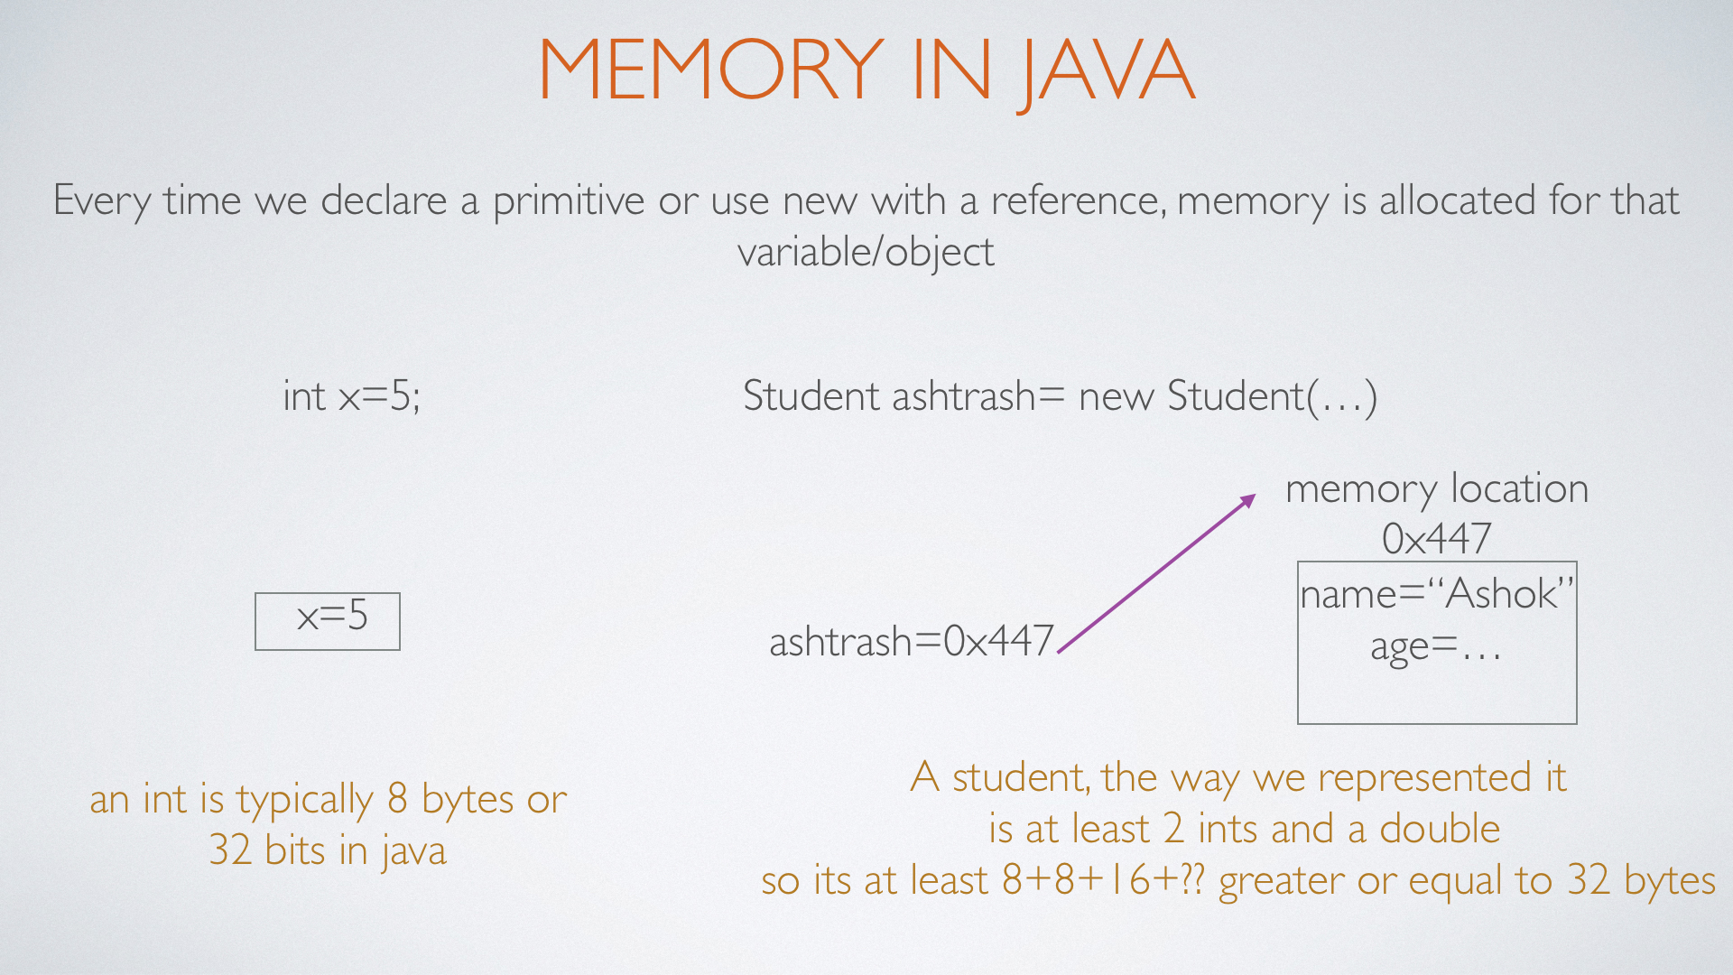

Slide 35
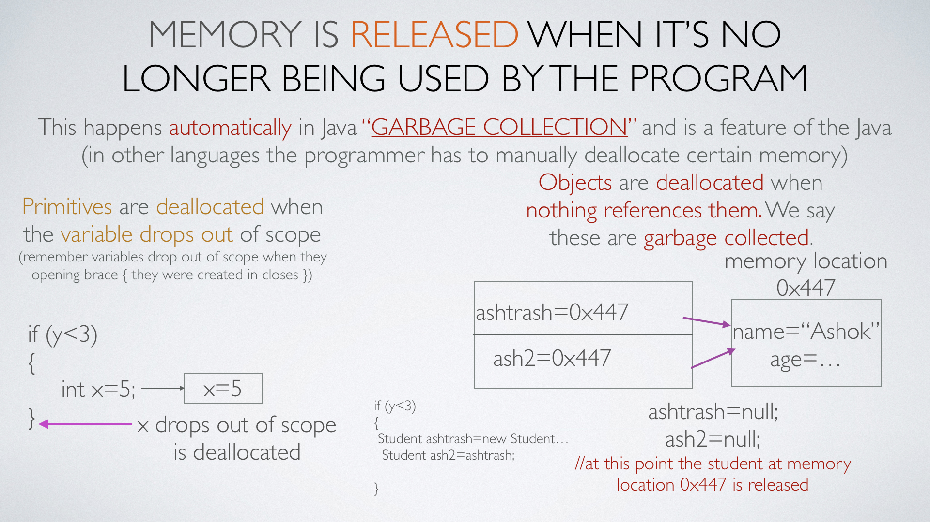

Slide 36
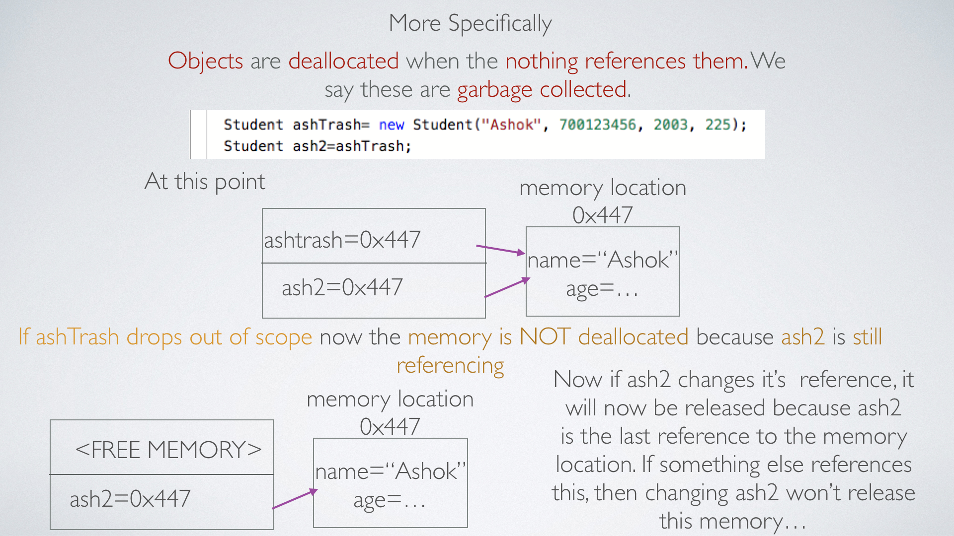

Slide 37
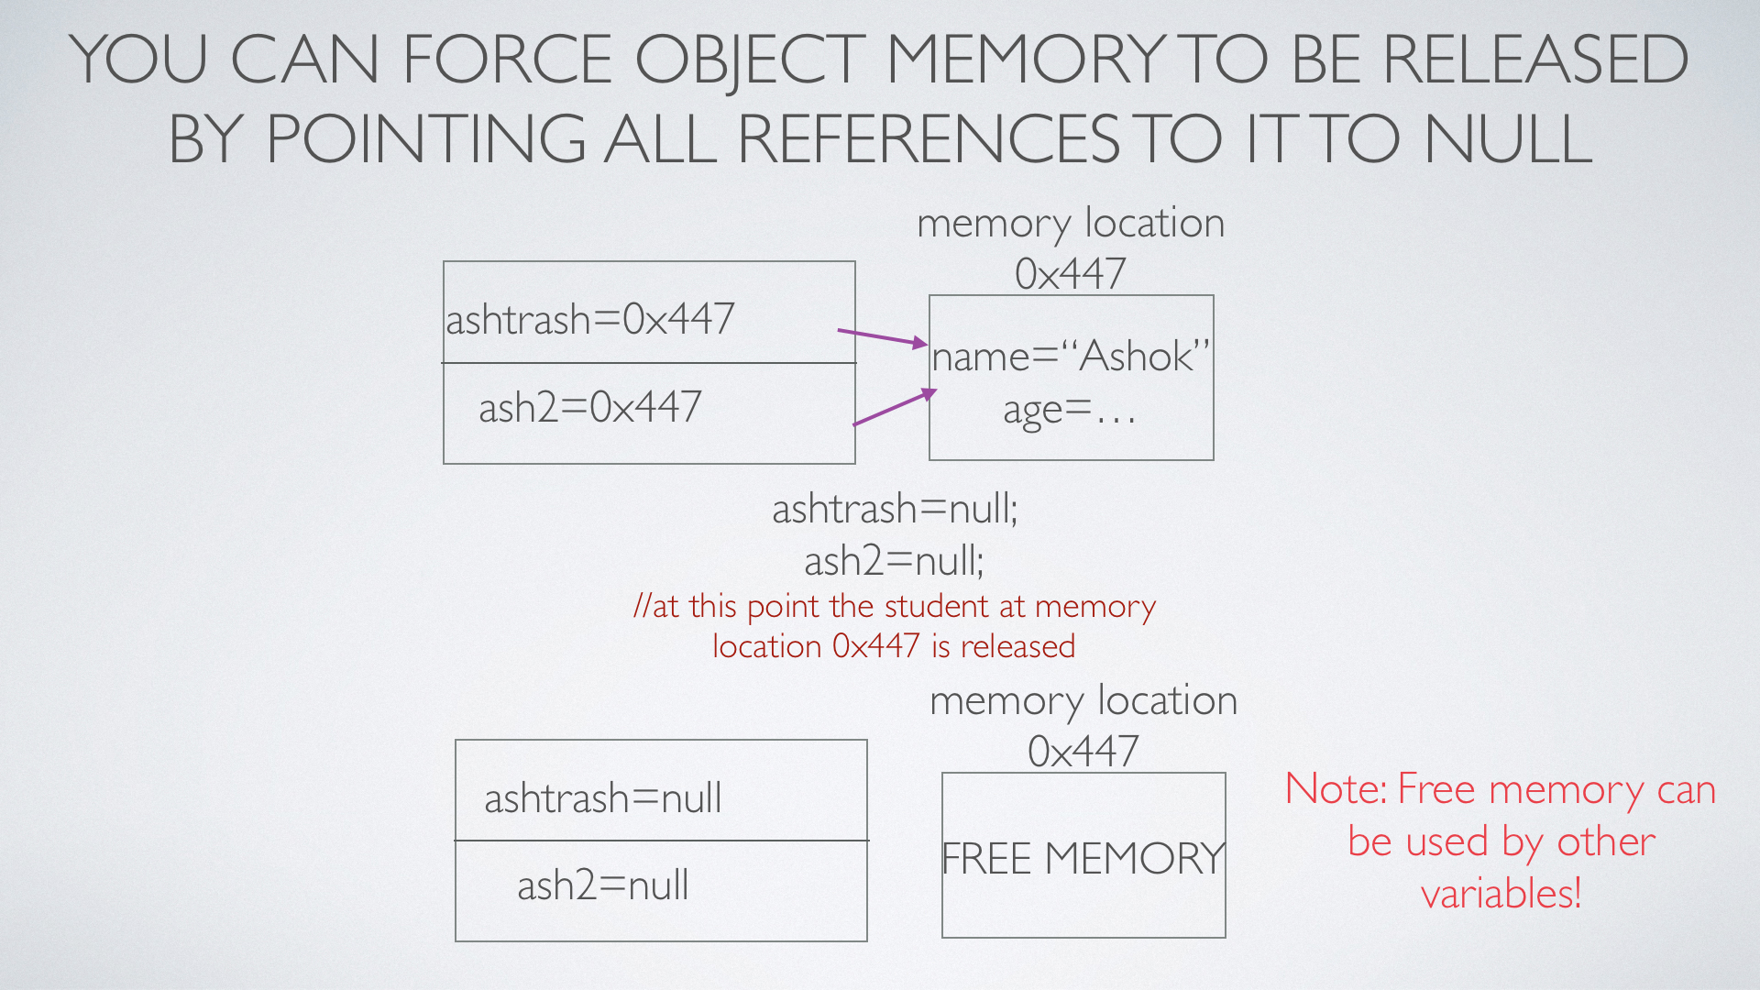

Slide 38
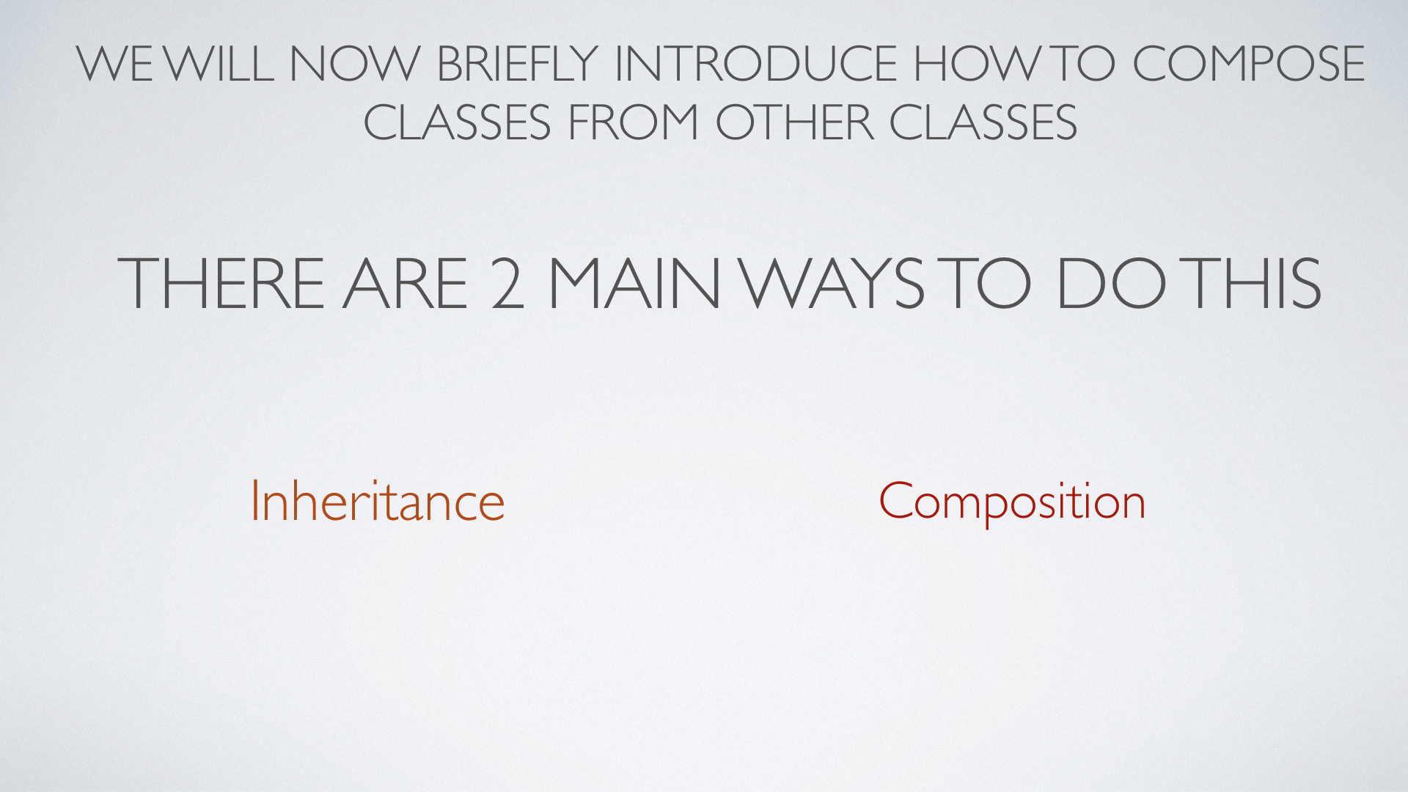

Slide 39
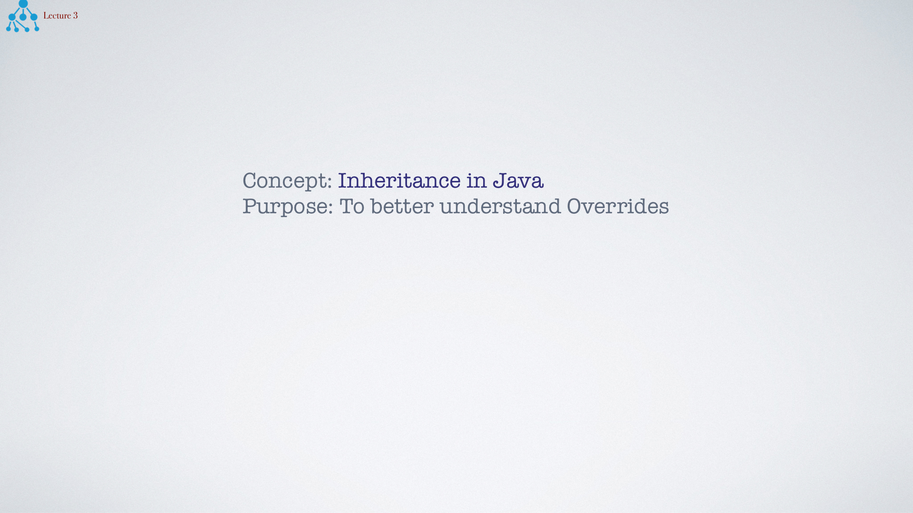

Slide 40
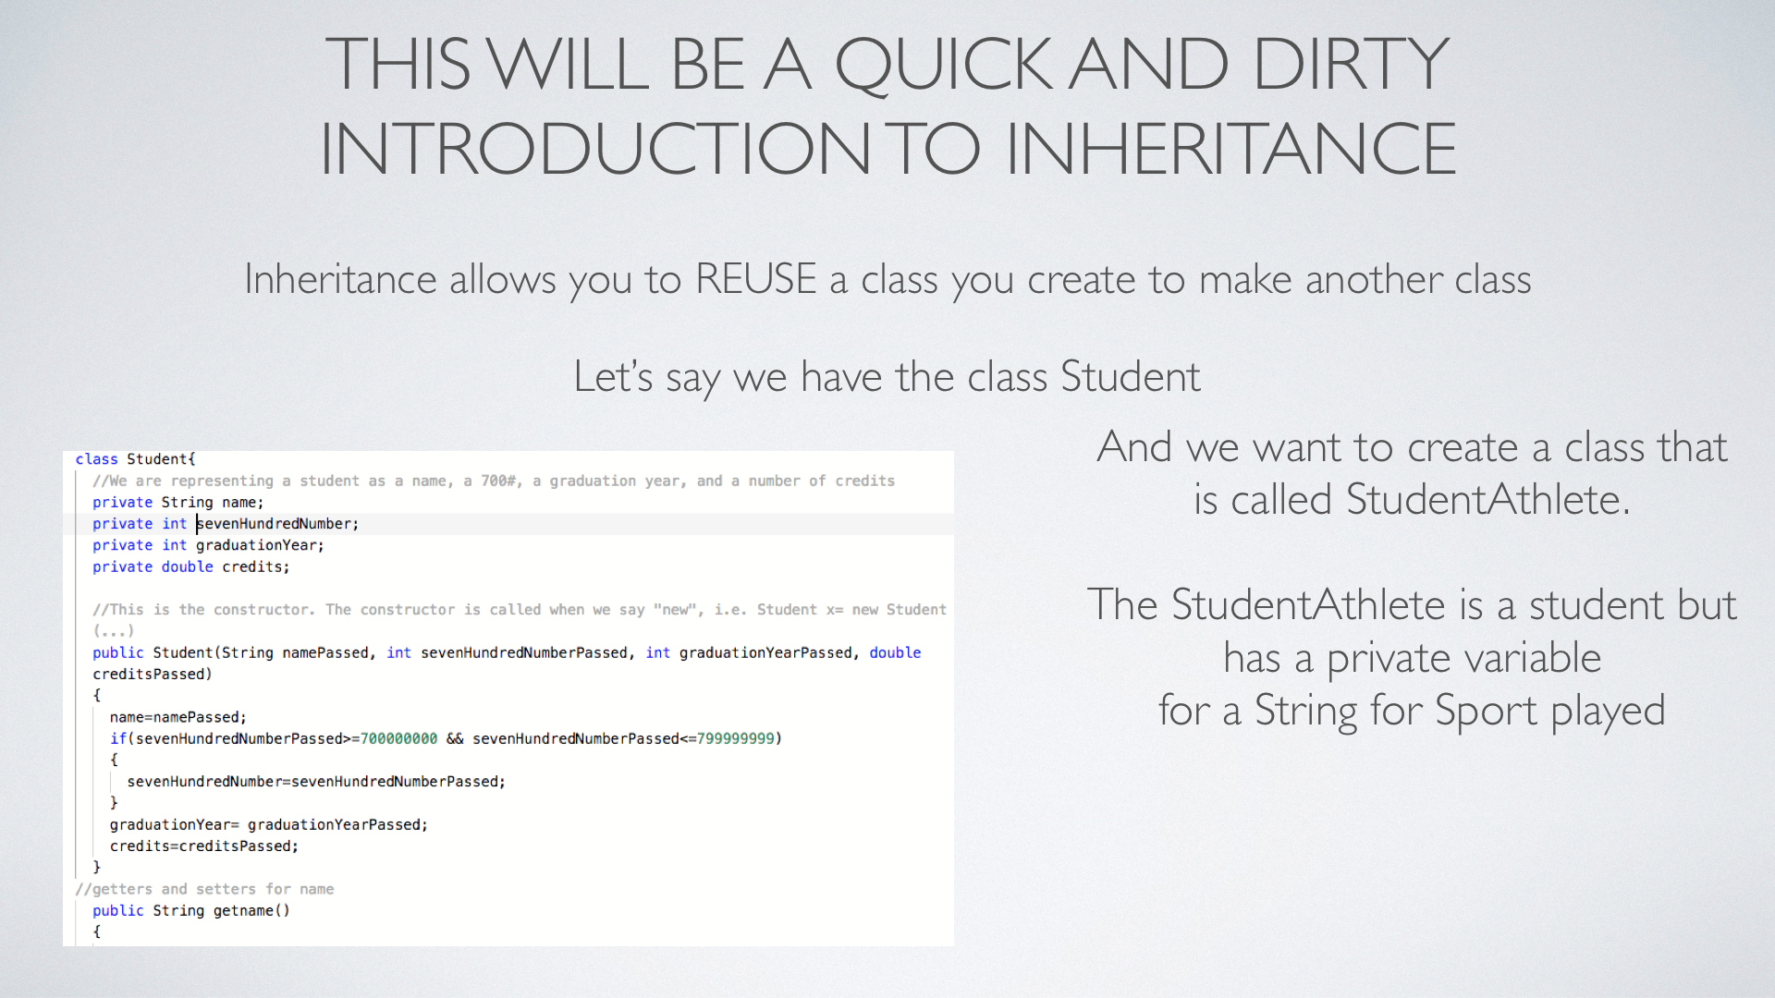

Slide 41
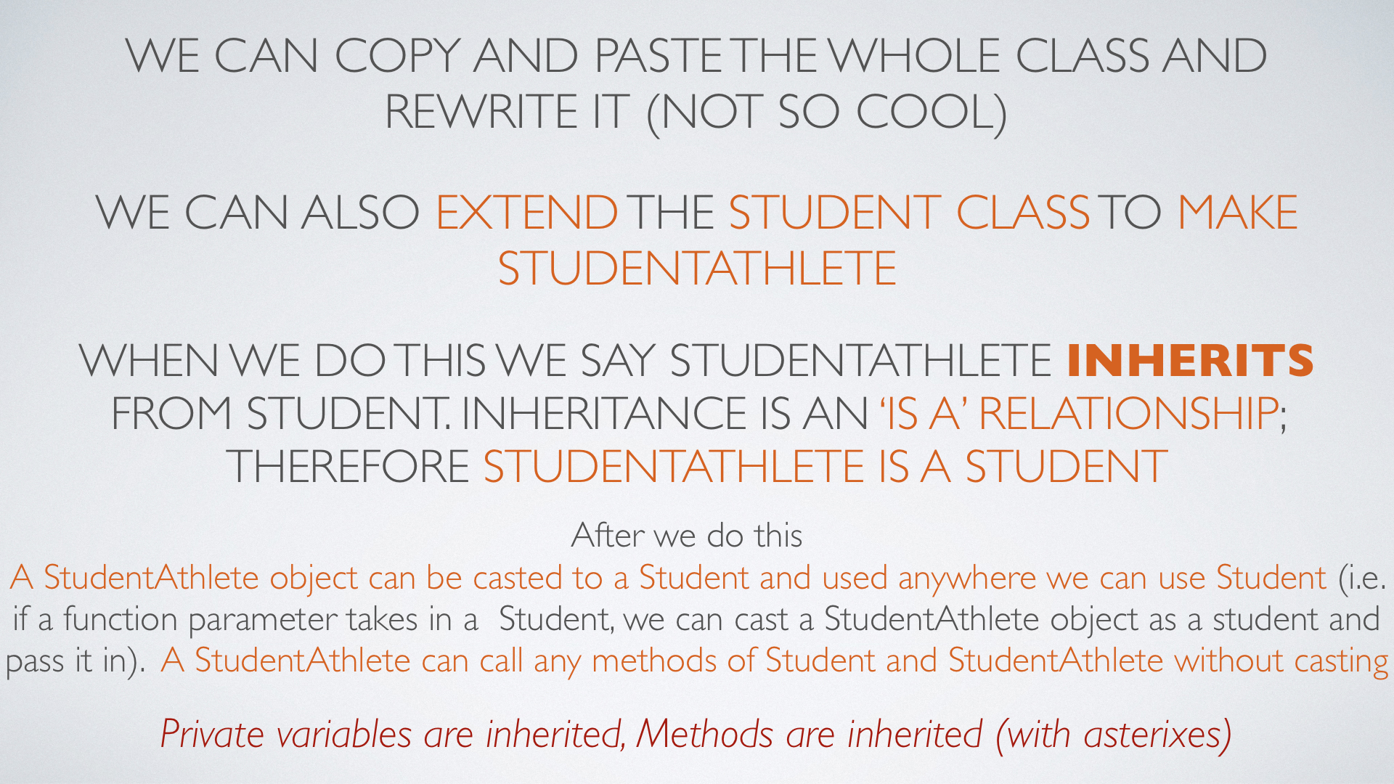

Slide 42
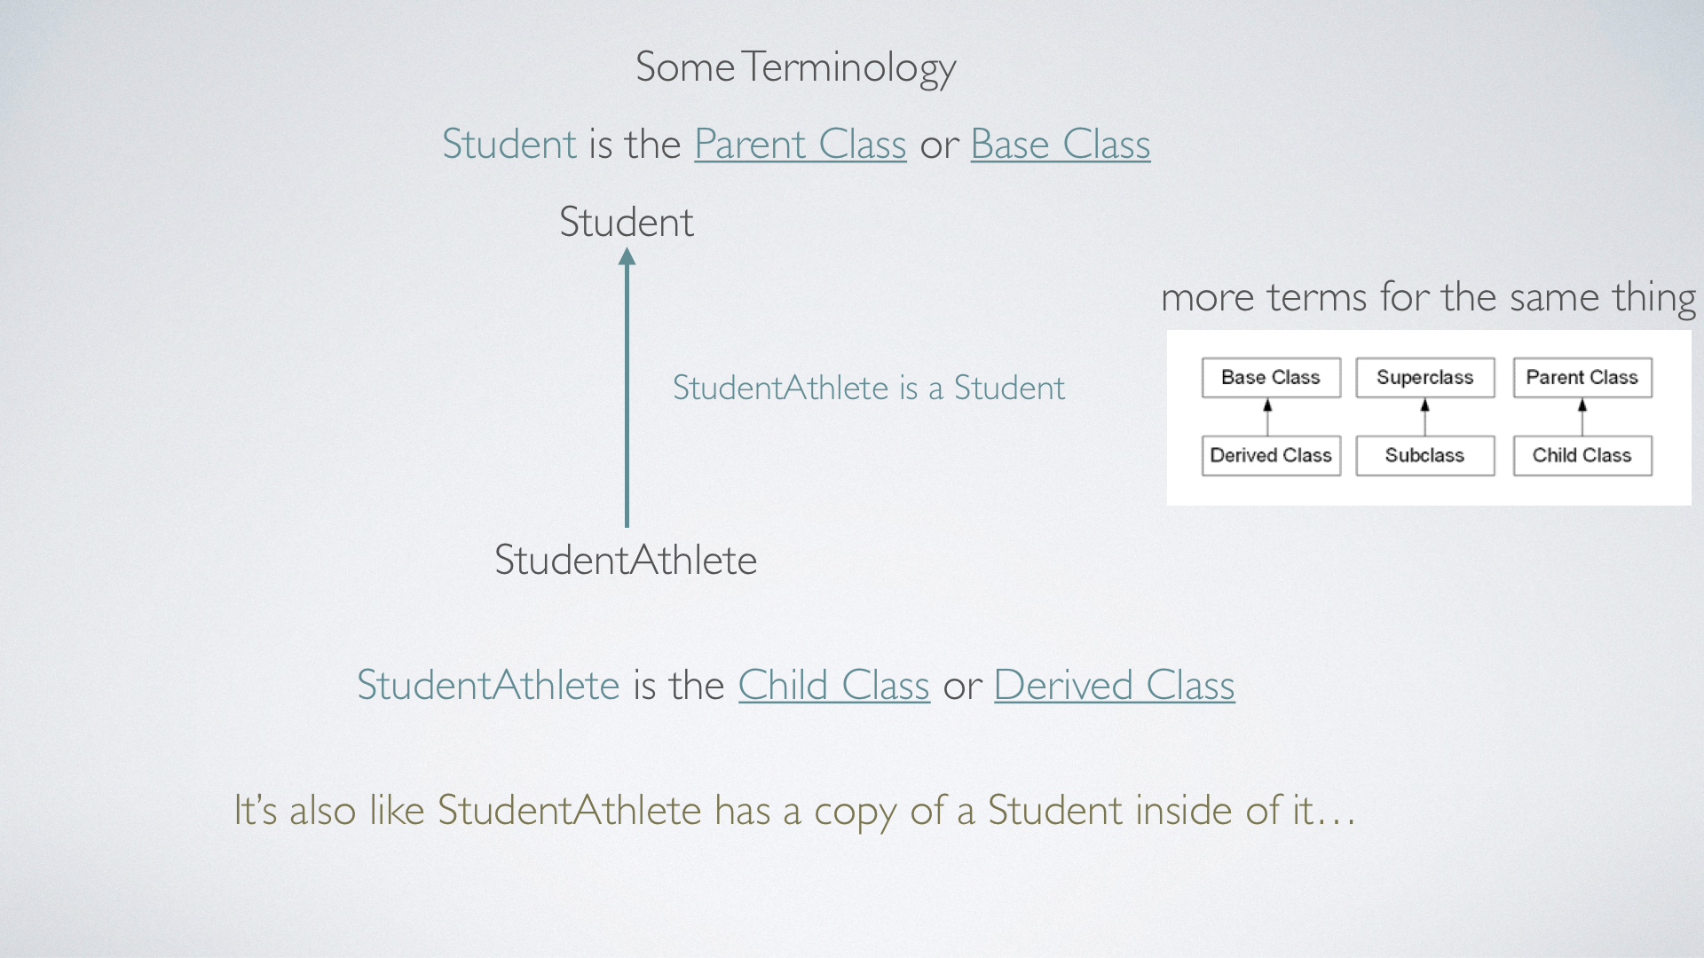

Slide 43
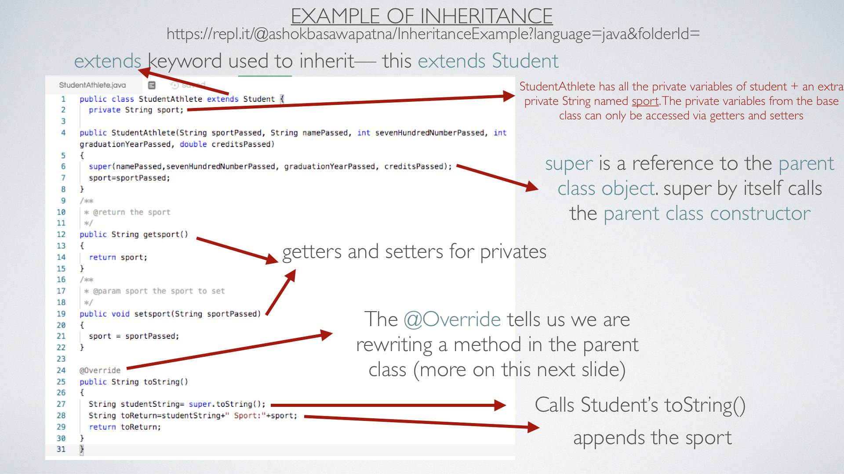
https://repl.it/@ashokbasawapatna/InheritanceExample

Slide 44
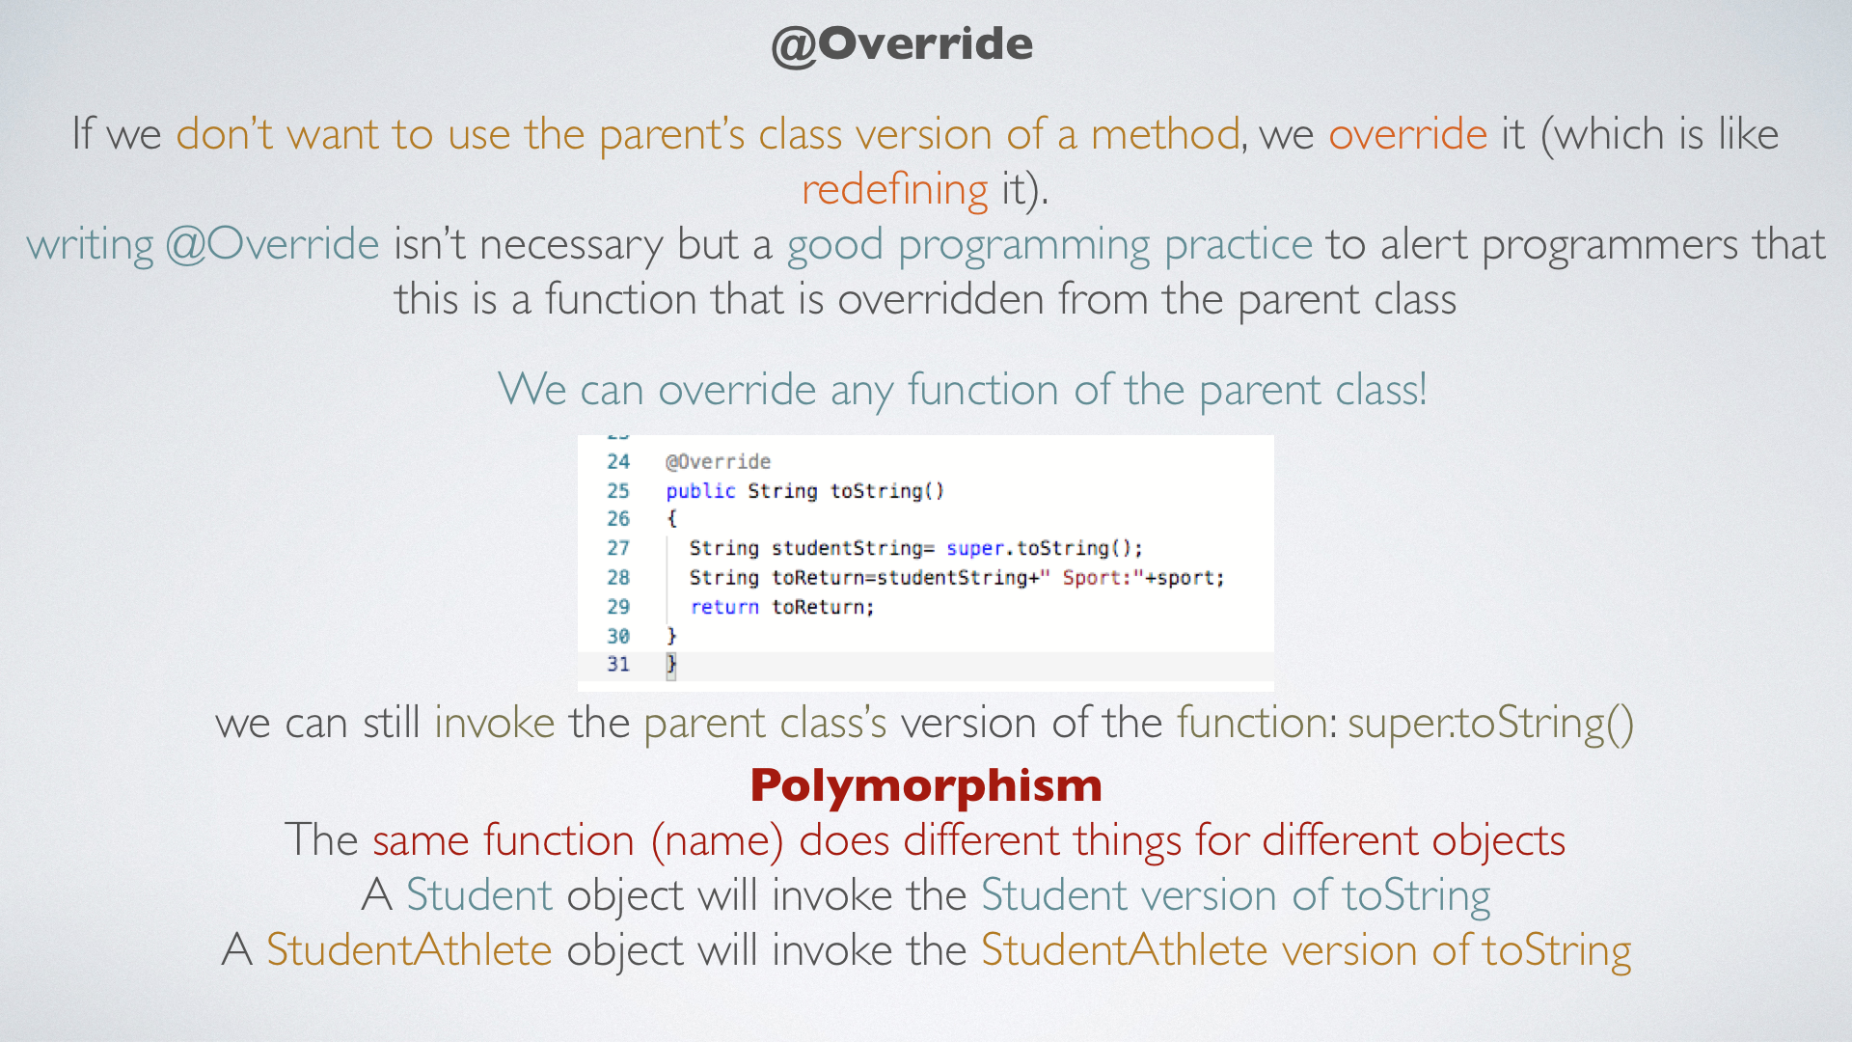

Slide 45
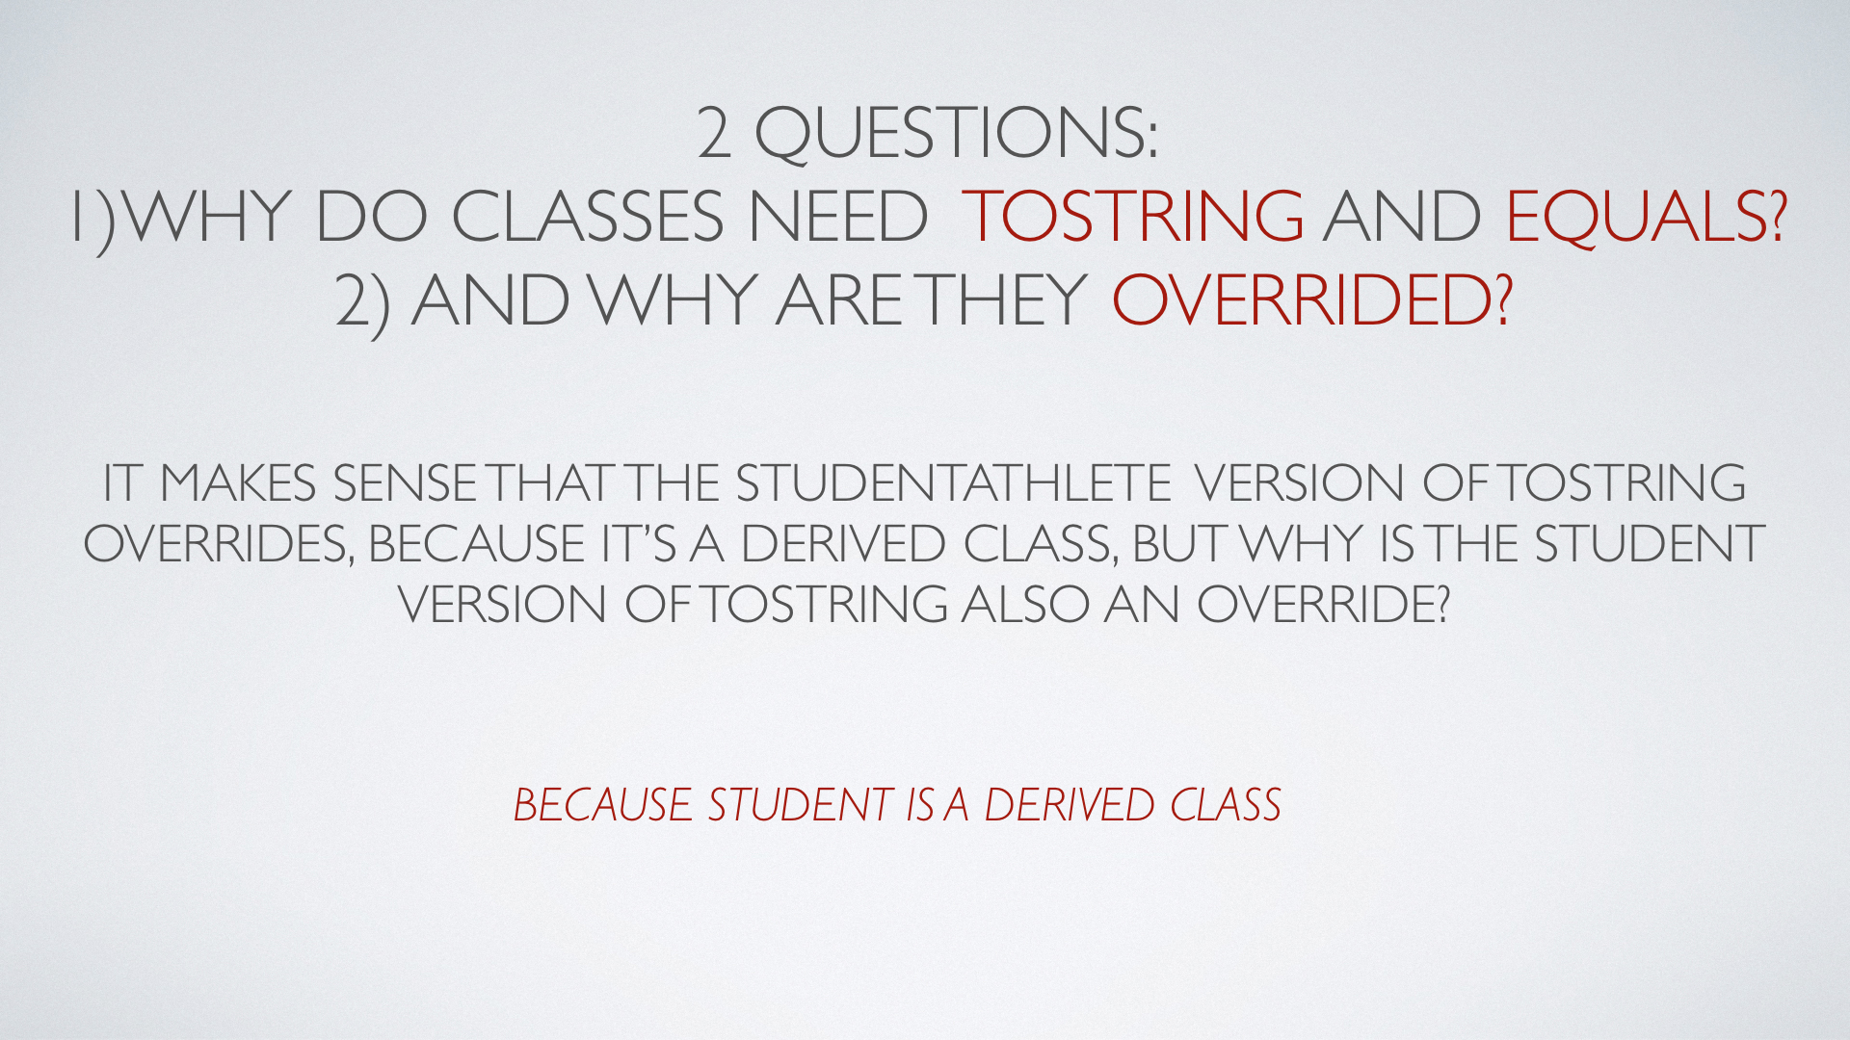

Slide 46
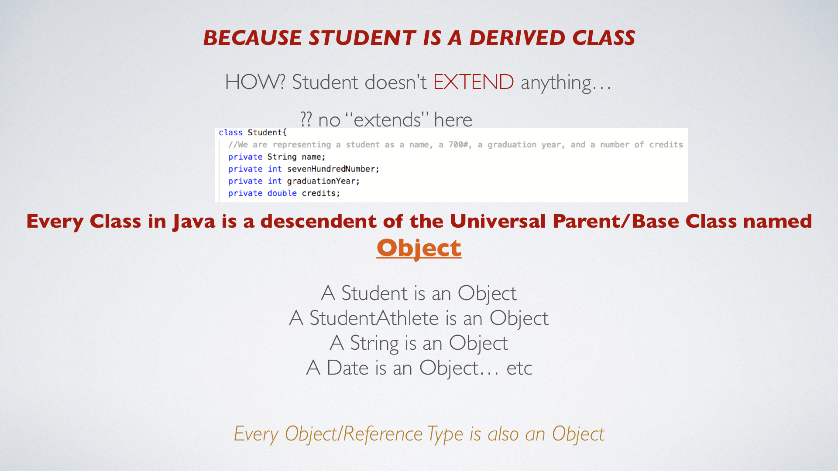

Slide 47
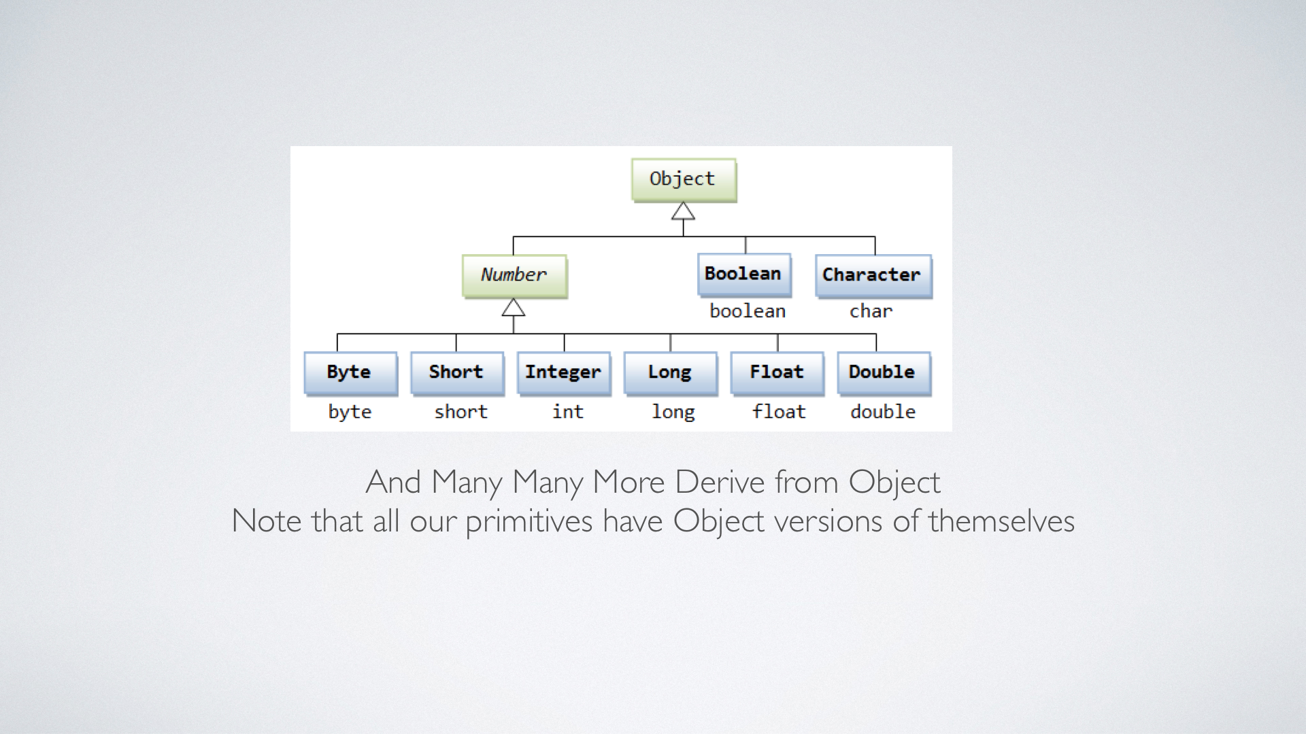

Slide 48
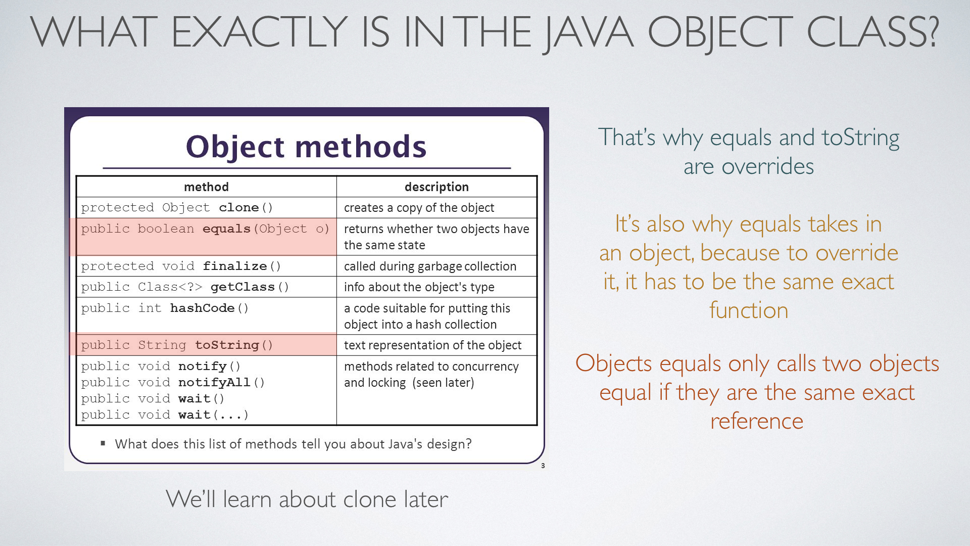

Slide 49
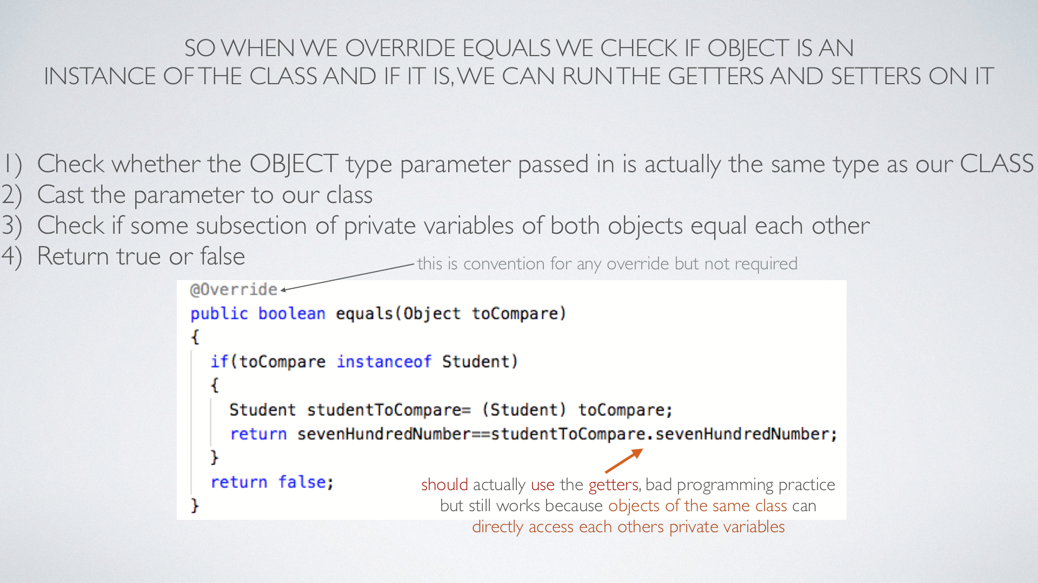

Slide 50
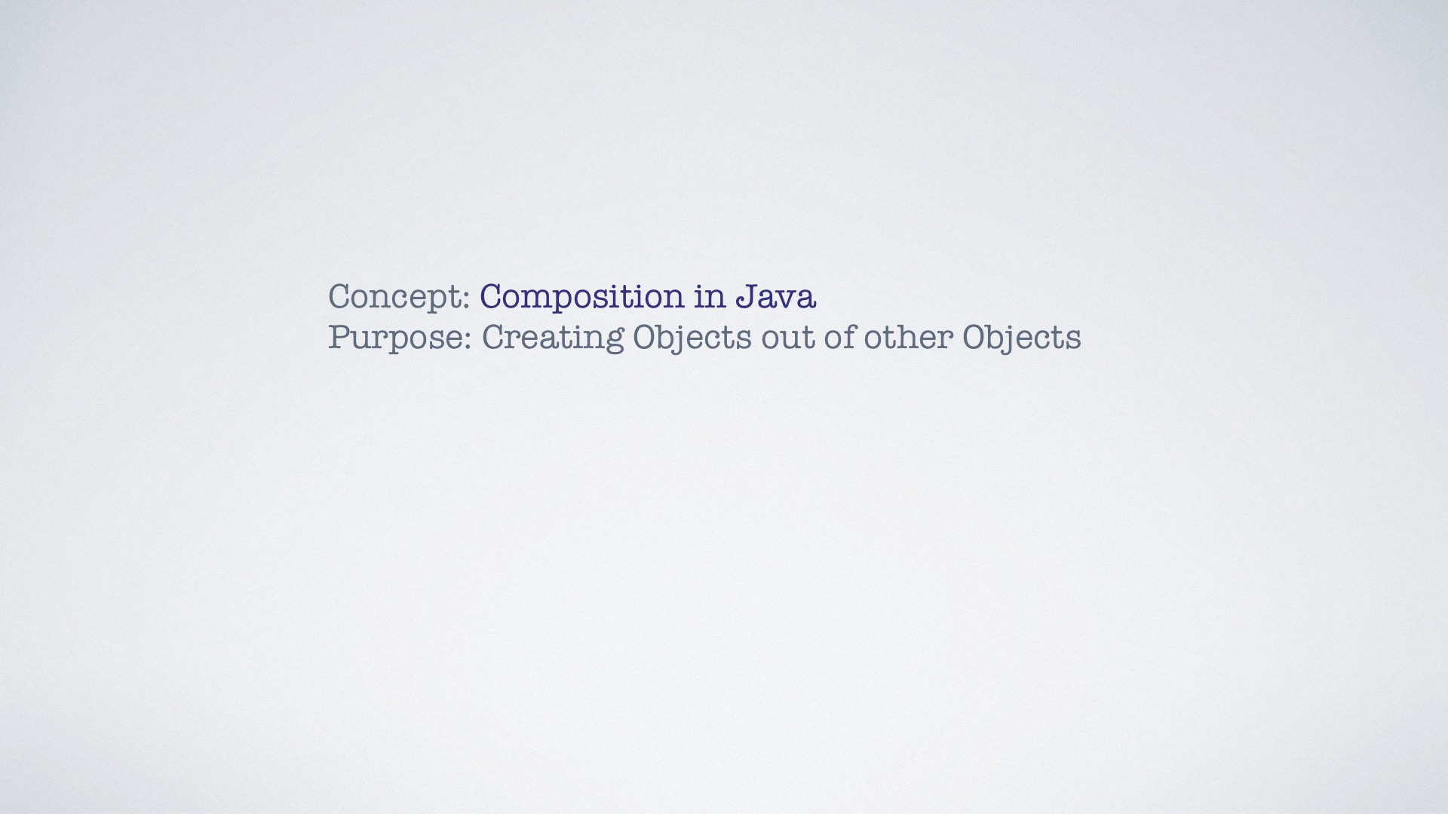

Slide 51
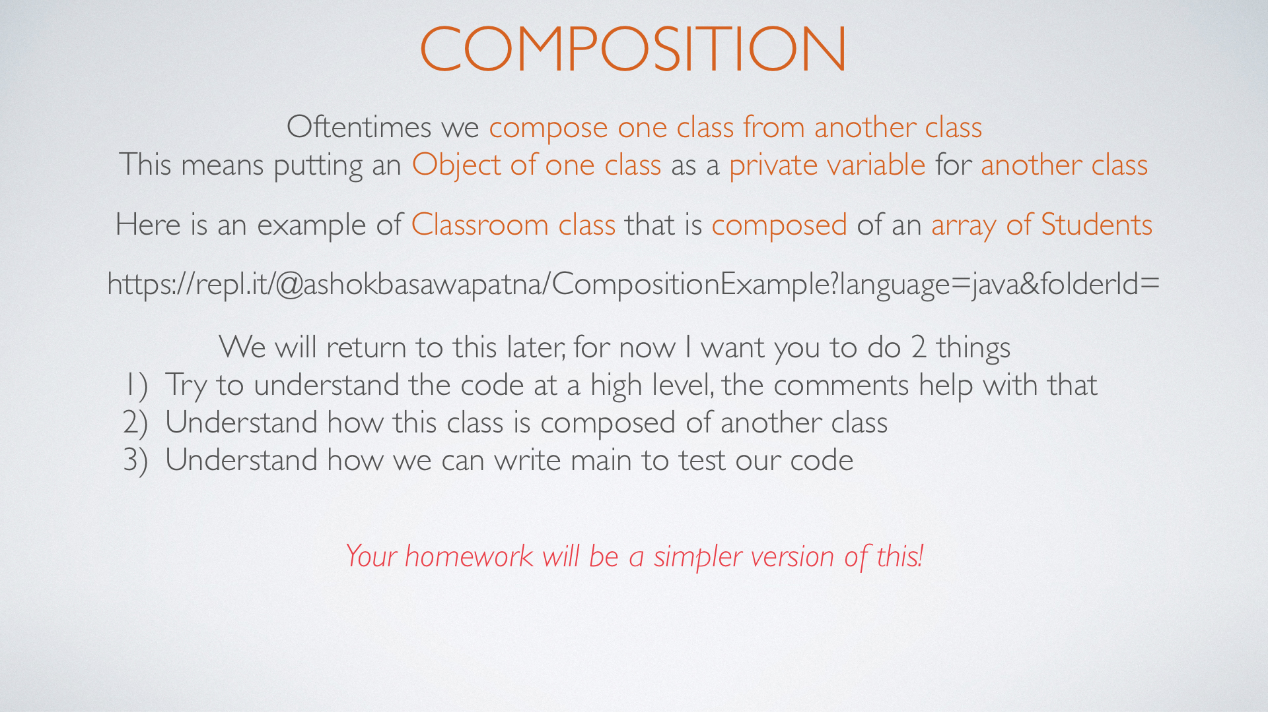
https://repl.it/@ashokbasawapatna/CompositionExample

Slide 52
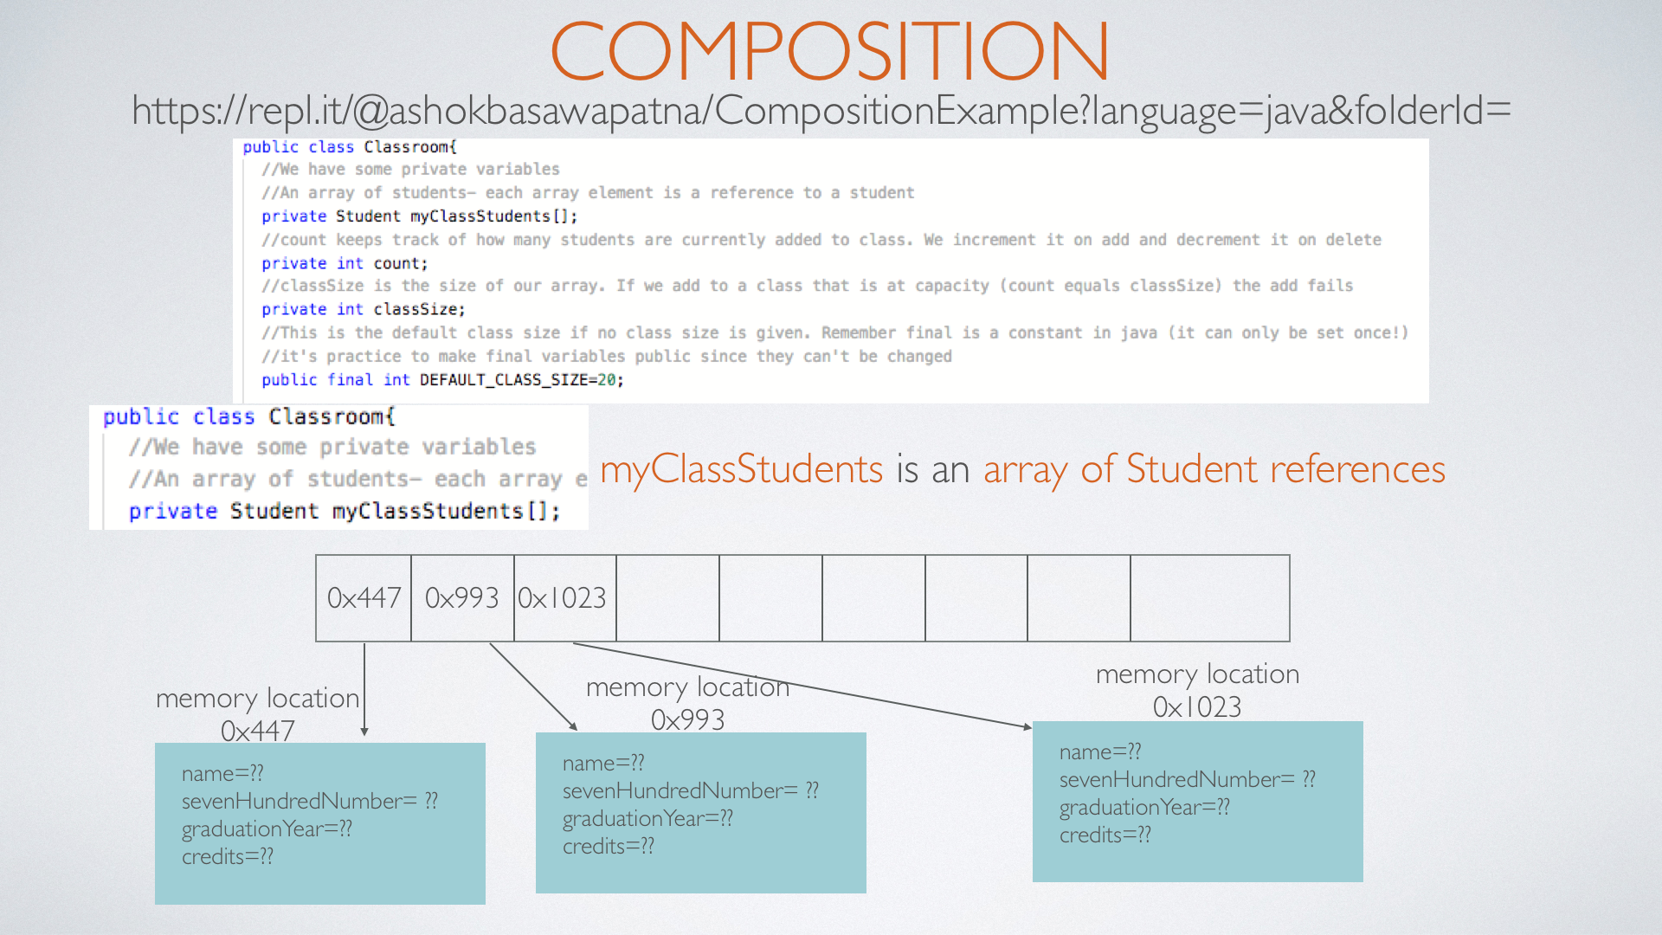
https://repl.it/@ashokbasawapatna/CompositionExample

Slide 53
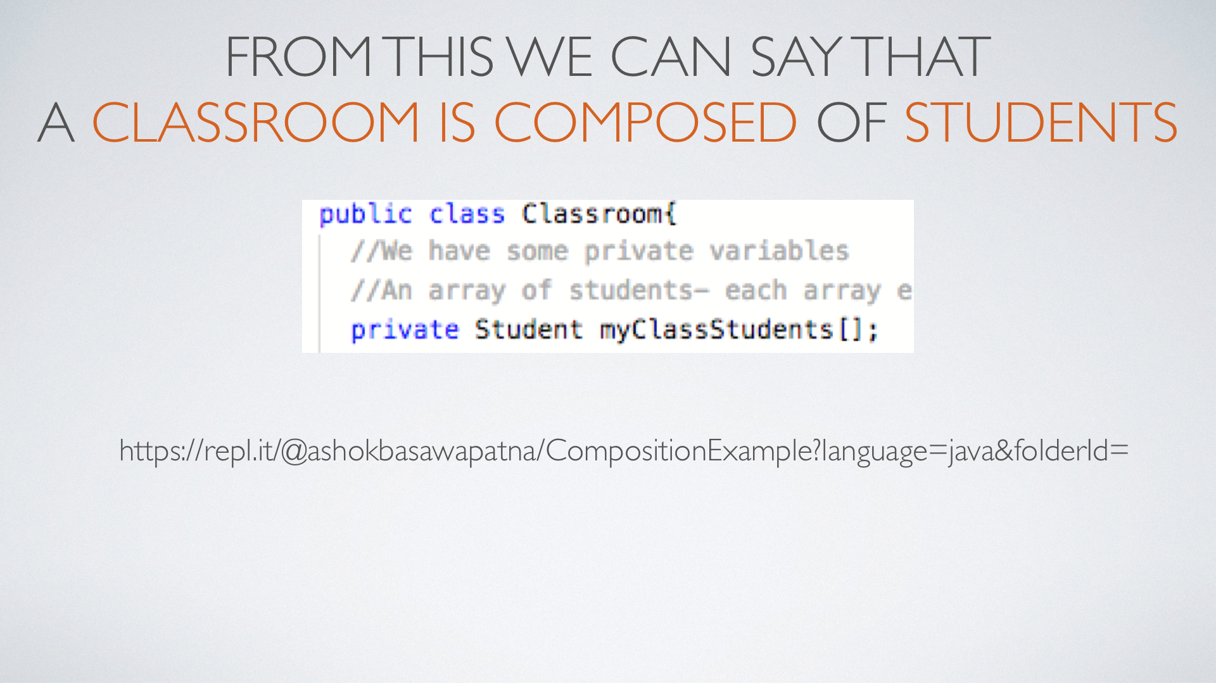
https://repl.it/@ashokbasawapatna/CompositionExample

Slide 54
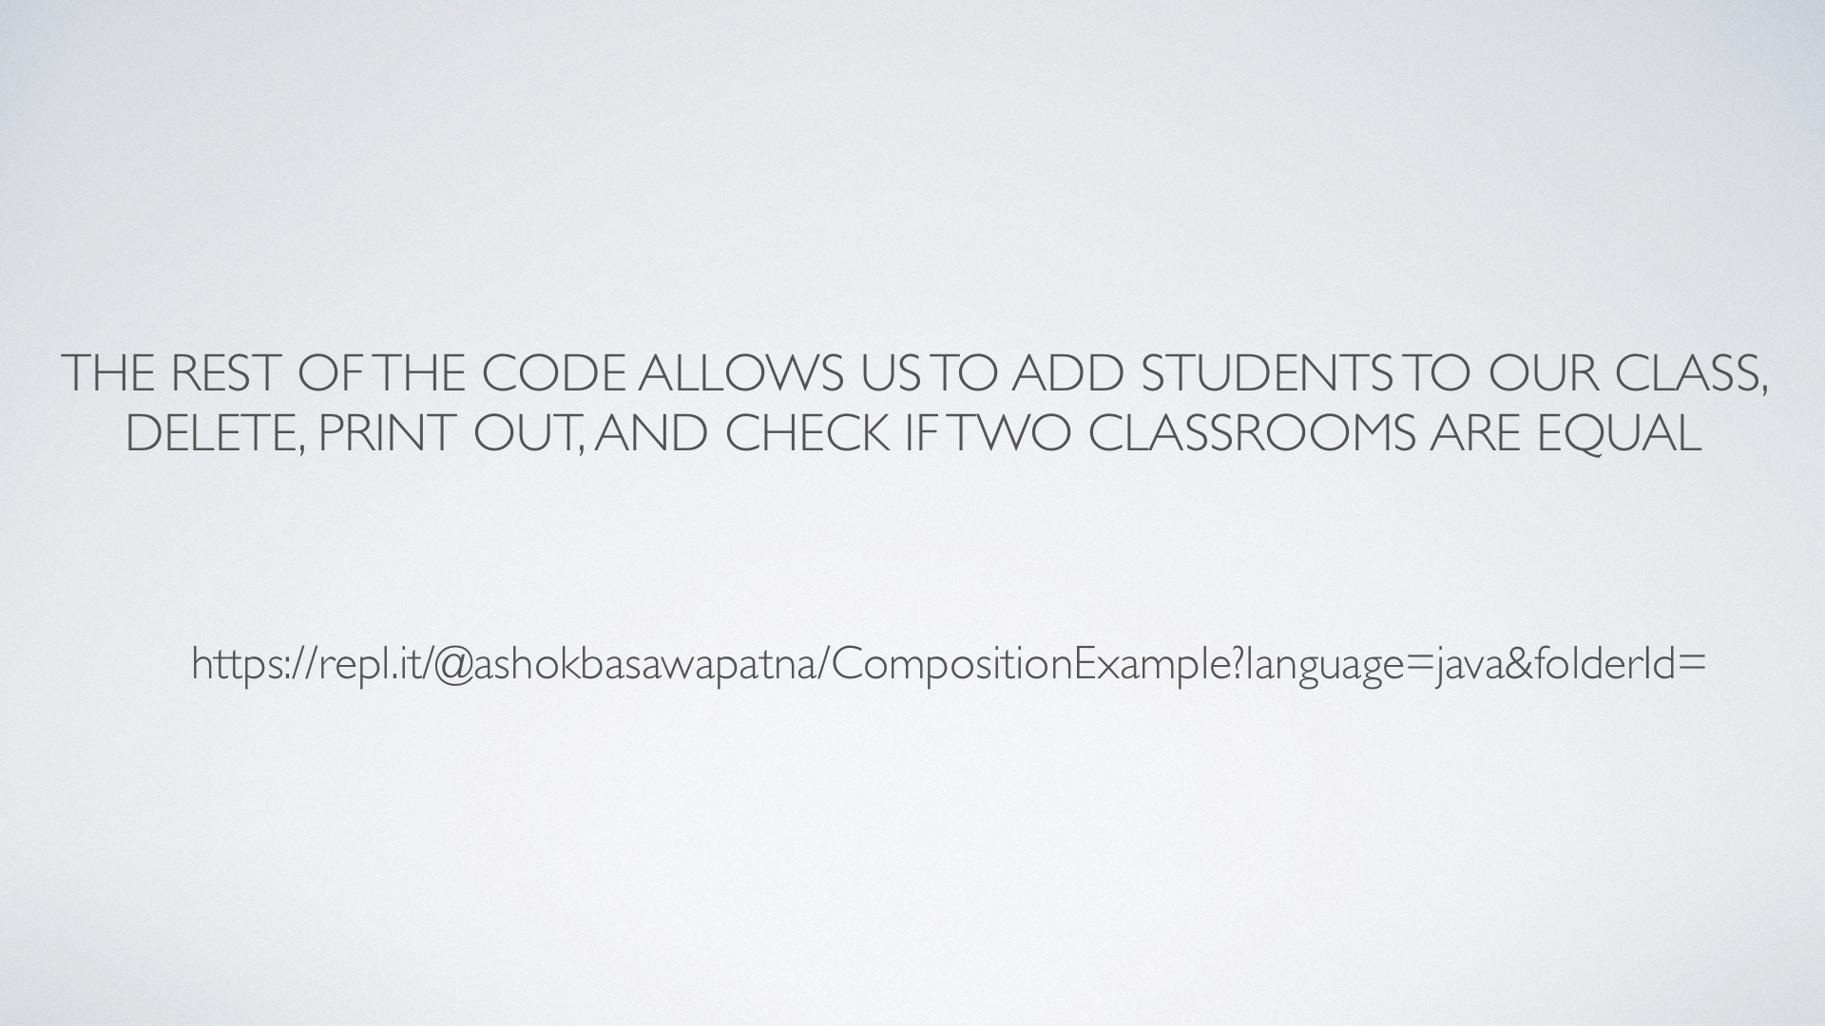
https://repl.it/@ashokbasawapatna/CompositionExample

Slide 55
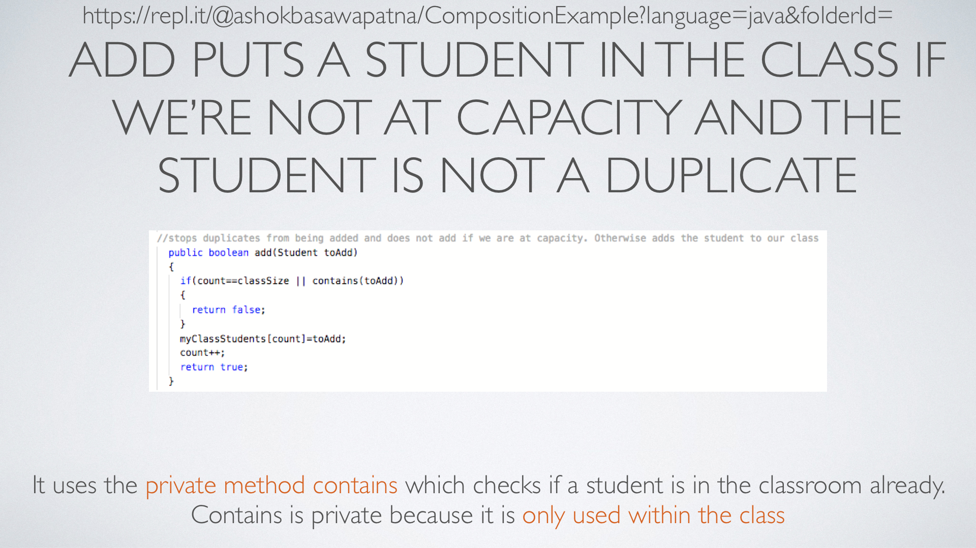
https://repl.it/@ashokbasawapatna/CompositionExample

Slide 56
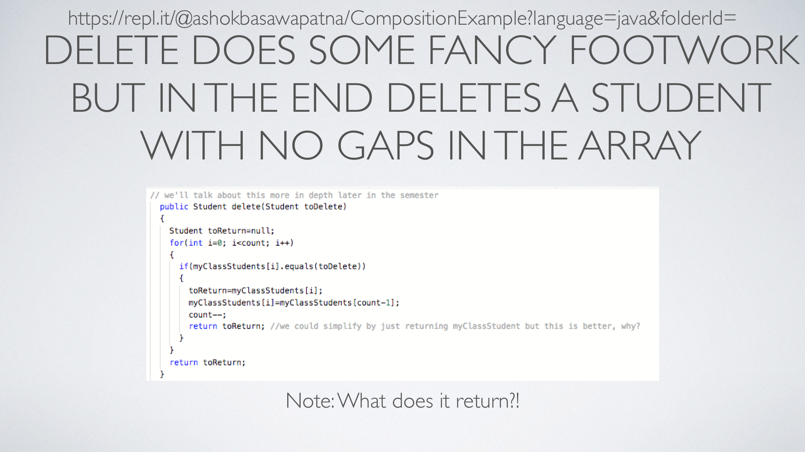
https://repl.it/@ashokbasawapatna/CompositionExample

Slide 57
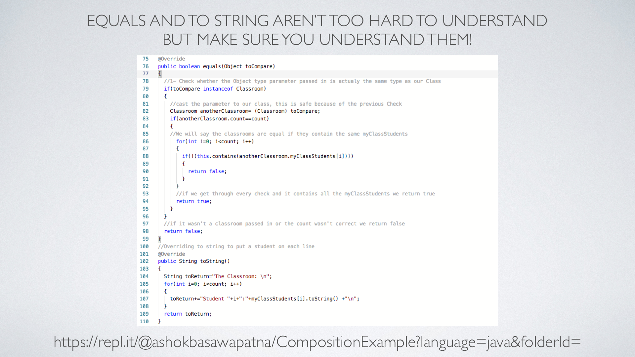
https://repl.it/@ashokbasawapatna/CompositionExample

Slide 58
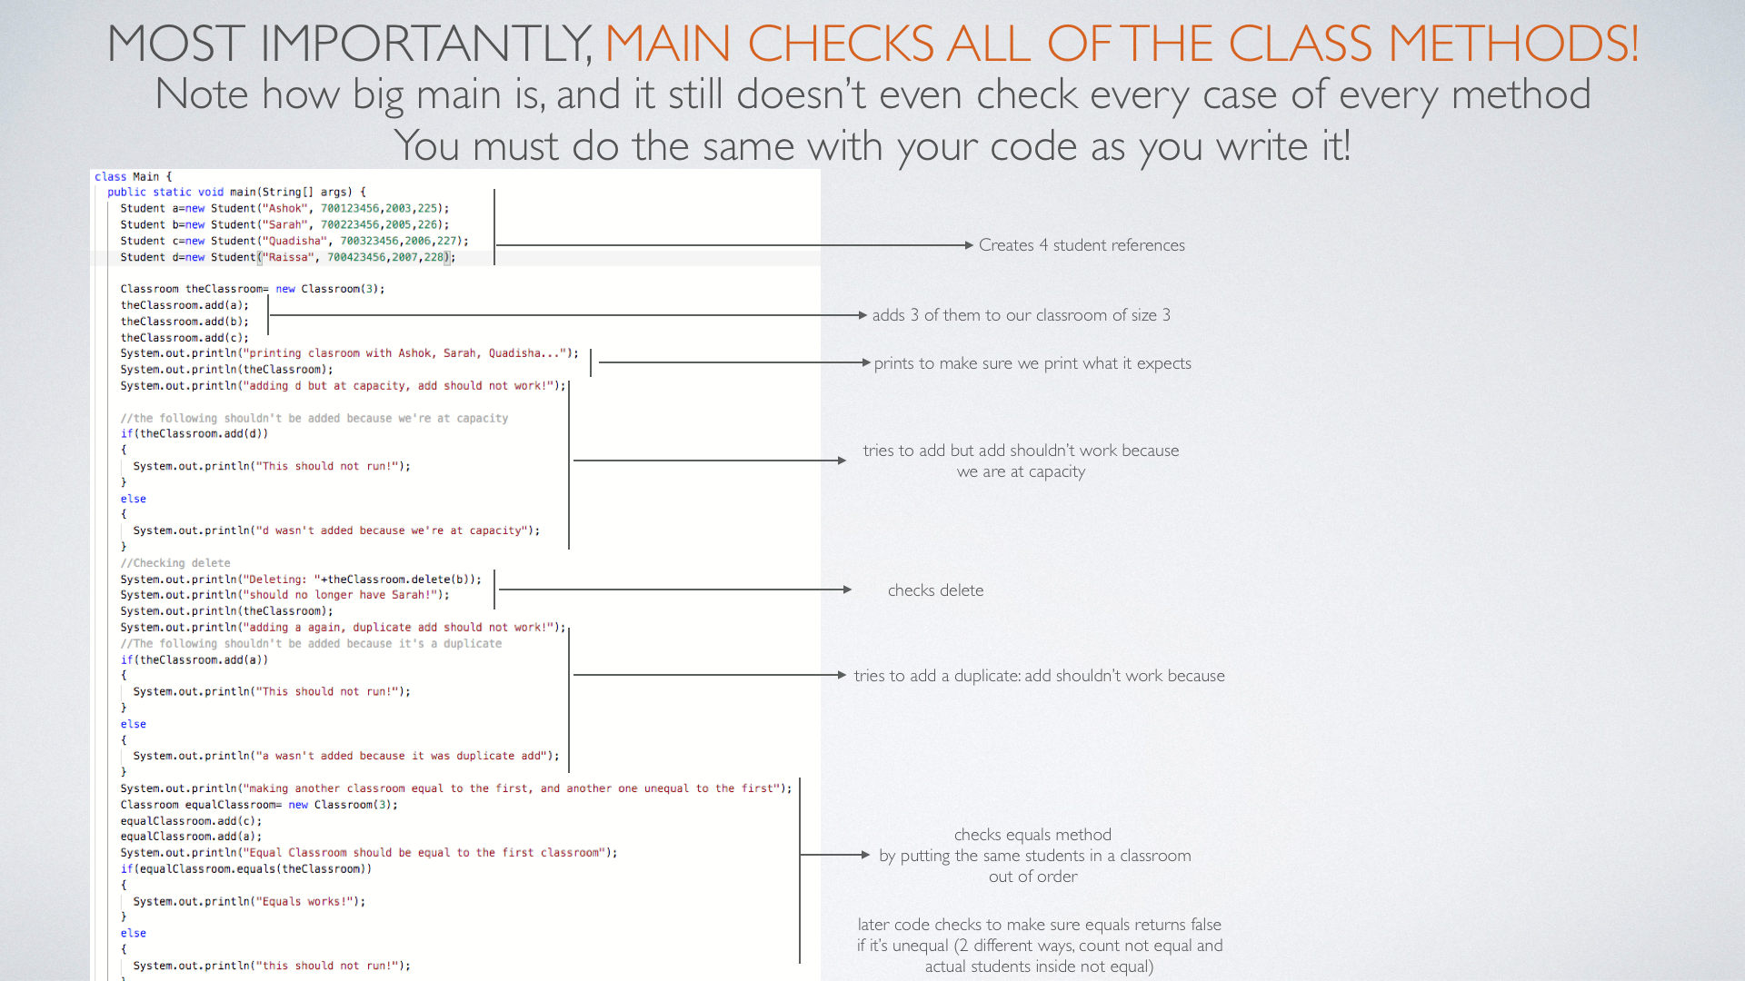
https://repl.it/@ashokbasawapatna/CompositionExample

Slide 59
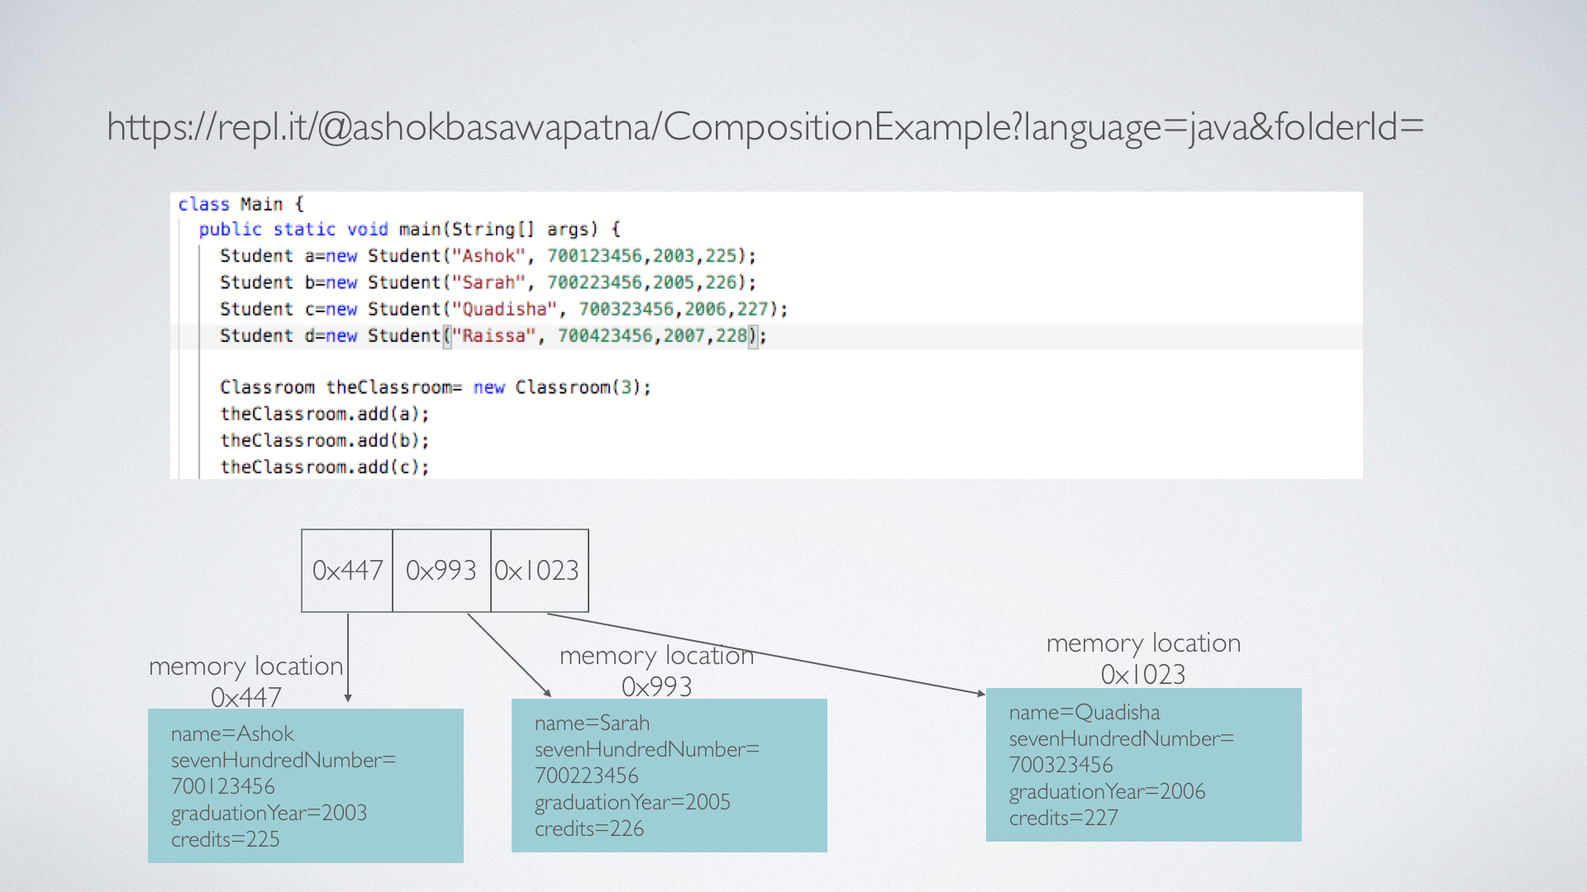

Slide 60
